Slide 1
SOL: Charity_App
Group 9
23 April 2025

Slide 2

About Us
Group 9 is part of the Encode Solana Rust Bootcamp, for the Q1 Cohort.

Slide 3
Problem
Customers
Market gap
40% - 65% of global charity donations are inefficient and therefore inadequately priced
Few(<50%), products on the market are priced so as to get aid where it’s needed, when its needed.
Costs
Geography
Loss of productivity/resources costing recipients thousands of dollars (>US$1 bn per annum)
More than 65% of global aid flows to Africa, Asia & Europe

Slide 4




Solution
Close the gap
Target audience
Cost savings
Easy to use
Our product makes recipients lives easier, and no other product on the market offers the same features​
NGOs based in Africa, Asia and Eastern Europe
Reduce expenses for cross border transfers by at least 30%
Simple design that gives recipients the targeted resources they need​

Slide 5



Product Overview
Unique
First to market
Only product specifically dedicated to this niche market
First beautifully designed product that's both stylish and functional​
Tested
Authentic
Testing done on the Solana Blockchain
Designed with the help and input of experts in the field ​

Slide 6
Project Demo

Slide 7
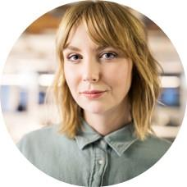

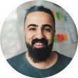

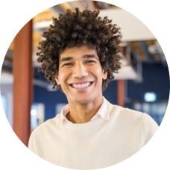

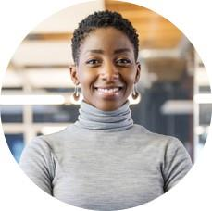
Our team
Takuma Hayashi​​
Mirjam Nilsson​​
Flora Berggren​​
Rajesh Santoshi​​
President
Chief Executive Officer​
Chief Operations Officer​
VP Marketing​
Graham Barnes​
Rowan Murphy​
Elizabeth Moore​
Robin Kline​
VP Product​
SEO Strategist​
Product Designer​
Content Developer​

Slide 8
Thank you
Mirjam Nilsson​​
206-555-0146​
mirjam@contoso.com​
www.contoso.com​

